Slide 1
S-7 | SLO-1 | Presettable counters
 | SLO-2 | Counter Design as a Synthesis problem

Slide 2
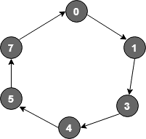
Counter design for given sequence
Problem – Design synchronous counter for sequence: 0 → 1 → 3 → 4 → 5 → 7 → 0, using T flip-flop.
Understanding the problem-
Count 7 is represented by 111, therefore 3 flip flops are required for the design
PRESENT STATE | NEXT STATE
0 | 1
1 | 3
3 | 4
4 | 5
5 | 7
7 | 0

Slide 3
State transition table and inputs to the flip flop for given sequence:
Write the input table of all T flip-flops by using the excitation table of T flip-flop.
Excitation table of T- flip flop
PRESENT STATE |  |  | NEXT STATE
Q₃ | Q₂ | Q₁ | Q₃(t+1) | Q₂(t+1) | Q₁(t+1)
0 | 0 | 0 | 0 | 0 | 1
0 | 0 | 1 | 0 | 1 | 1
0 | 1 | 1 | 1 | 0 | 0
1 | 0 | 0 | 1 | 0 | 1
1 | 0 | 1 | 1 | 1 | 1
1 | 1 | 1 | 0 | 0 | 0
INPUT TABLE OF FLIP-FLOPS
T₃ | T₂ | T₁
0 | 0 | 1
0 | 1 | 0
1 | 1 | 1
0 | 0 | 1
0 | 1 | 0
1 | 1 | 1
QT | QT+1 | T
0 | 0 | 0
0 | 1 | 1
1 | 0 | 1
1 | 1 | 0

Slide 4
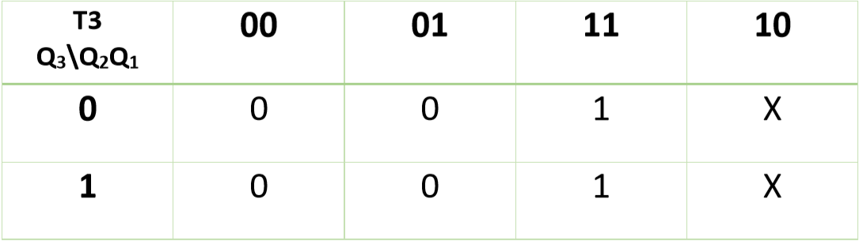
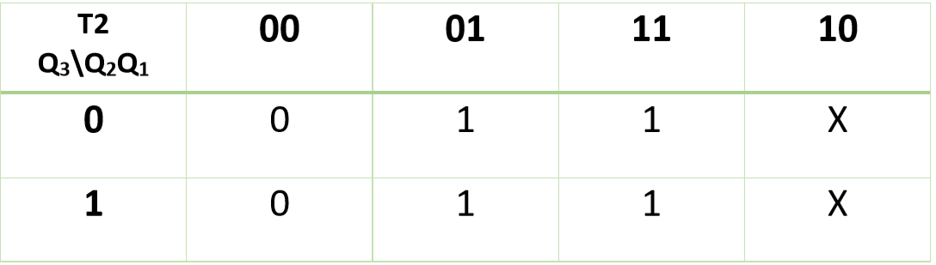
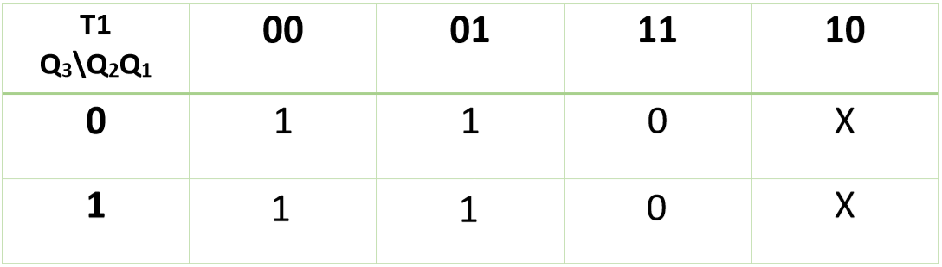
Find value of T3, T2, T1 in terms of Q3, Q2, Q1 using K-Map (Karnaugh Map):
T3 = Q2
T2 = Q1
T1 = Q2’

Slide 5
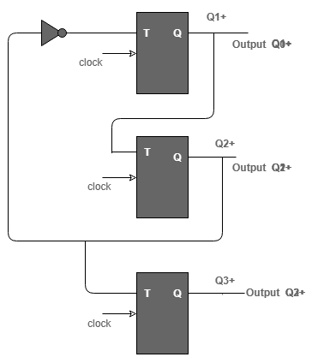
Implementation of the design
T1 = Q2’
T2 = Q1 + Q2
T3 = Q2

Slide 6
Counter design for given sequence considering unused states
Problem – Design a mod -5 counter for sequence: 2 → 3 → 5 → 1 → 7 → 2, using D flip-flop. The counter must be self starting with count states 0,4,6 leading directly to 2.
Understanding the problem-
Mod 5 counter requires 5 unique states, therefore 3 flip flops are required for the design
PRESENT STATE | NEXT STATE
2 | 3
3 | 5
5 | 1
1 | 7
7 | 2
0 | 2
4 | 2
6 | 2
0
4
6
2
3
7
1
5

Slide 7
State transition table and inputs to the flip flop for given sequence:
Write the input table of all T flip-flops by using the excitation table of D flip-flop.
Excitation table of D- flip flop
PRESENT STATE |  |  | NEXT STATE
Q₃ | Q₂ | Q₁ | Q₃(t+1) | Q₂(t+1) | Q₁(t+1)
0 | 0 | 0 | 0 | 1 | 0
0 | 0 | 1 | 1 | 1 | 1
0 | 1 | 0 | 0 | 1 | 1
0 | 1 | 1 | 1 | 0 | 1
1 | 0 | 0 | 0 | 1 | 0
1 | 0 | 1 | 0 | 0 | 1
1 | 1 | 0 | 0 | 1 | 0
1 | 1 | 1 | 0 | 1 | 0
INPUT TABLE OF FLIP-FLOPS
D₃ | D₂ | D₁
0 | 1 | 0
1 | 1 | 1
0 | 1 | 1
1 | 0 | 1
0 | 1 | 0
0 | 0 | 1
0 | 1 | 0
0 | 1 | 0
QT | Q (t+1) | D
0 | 0 | 0
0 | 1 | 1
1 | 0 | 0
1 | 1 | 1

Slide 8
Find value of D3, D2, D1 in terms of Q3, Q2, Q1 using K-Map (Karnaugh Map):
D3 Q3\Q2Q1 | 00 | 01 | 11 | 10
0 | 0 | 1 | 1 | 0
1 | 0 | 0 | 0 | 0
D3=Q3’Q1
D2=Q1’+ Q3’Q2’+ Q3Q2
D1=Q2’Q1+ Q3’Q2
D2 Q3\Q2Q1 | 00 | 01 | 11 | 10
0 | 1 | 1 | 0 | 1
1 | 1 | 0 | 1 | 1
D1 Q3\Q2Q1 | 00 | 01 | 11 | 10
0 | 0 | 1 | 1 | 1
1 | 0 | 1 | 0 | 0

Slide 9
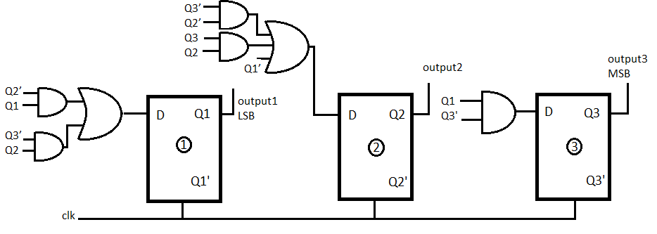
Implementation of the design
D3=Q3’Q1
D2=Q1’+ Q3’Q2’+ Q3Q2
D1=Q2’Q1+ Q3’Q2

Slide 10
Counter design for given sequence considering unused states
Problem – Design a mod -5 counter for sequence: 2 → 3 → 5 → 1 → 7 → 2, using D flip-flop. The counter must be self starting with count states 0 to 1, 4 to 5,and 6 to 7.
Understanding the problem-
Mod 5 counter requires 5 unique states, therefore 3 flip flops are required for the design
PRESENT STATE | NEXT STATE
2 | 3
3 | 5
5 | 1
1 | 7
7 | 2
0 | 1
4 | 5
6 | 7
2
3
6
7
1
5
4
0

Slide 11
State transition table and inputs to the flip flop for given sequence:
Write the input table of all T flip-flops by using the excitation table of D flip-flop.
Excitation table of D- flip flop
PRESENT STATE |  |  | NEXT STATE
Q₃ | Q₂ | Q₁ | Q₃(t+1) | Q₂(t+1) | Q₁(t+1)
0 | 0 | 0 | 0 | 0 | 1
0 | 0 | 1 | 1 | 1 | 1
0 | 1 | 0 | 0 | 1 | 1
0 | 1 | 1 | 1 | 0 | 1
1 | 0 | 0 | 1 | 0 | 1
1 | 0 | 1 | 0 | 0 | 1
1 | 1 | 0 | 1 | 1 | 1
1 | 1 | 1 | 0 | 1 | 0
INPUT TABLE OF FLIP-FLOPS
D₃ | D₂ | D₁
0 | 0 | 1
1 | 1 | 1
0 | 1 | 1
1 | 0 | 1
1 | 0 | 1
0 | 0 | 1
1 | 1 | 1
0 | 1 | 0
2
3
6
7
1
5
4
0
QT | Q (t+1) | D
0 | 0 | 0
0 | 1 | 1
1 | 0 | 0
1 | 1 | 1

Slide 12
Find value of D3, D2, D1 in terms of Q3, Q2, Q1 using K-Map (Karnaugh Map):
D3 Q3\Q2Q1 | 00 | 01 | 11 | 10
0 | 0 | 1 | 1 | 0
1 | 1 | 0 | 0 | 1
D3=Q3’Q1 +Q3Q1’
D2=Q2Q1’+ Q3’Q2’Q1+ Q3Q2
D1=Q1’+ Q3’+Q2’
INPUT TABLE OF FLIP-FLOPS
D₃ | D₂ | D₁
0 | 0 | 1
1 | 1 | 1
0 | 1 | 1
1 | 0 | 1
1 | 0 | 1
0 | 0 | 1
1 | 1 | 1
0 | 1 | 0
D2 Q3\Q2Q1 | 00 | 01 | 11 | 10
0 | 0 | 1 | 0 | 1
1 | 0 | 0 | 1 | 1
D1 Q3\Q2Q1 | 00 | 01 | 11 | 10
0 | 1 | 1 | 1 | 1
1 | 1 | 1 | 0 | 1

Slide 13
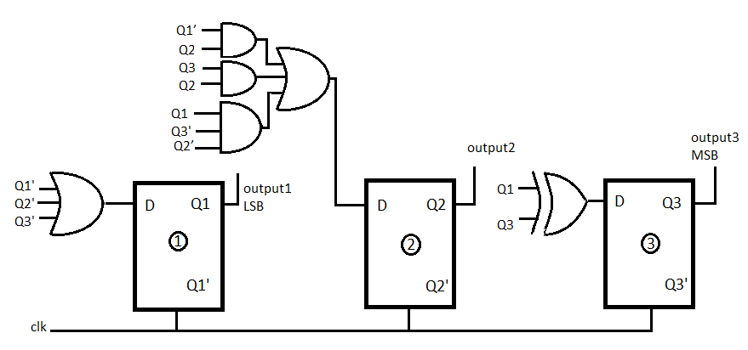
Implementation of the design
D3=Q3’Q1 +Q3Q1’
D2=Q2Q1’+ Q3’Q2’Q1+ Q3Q2
D1=Q1’+ Q3’+Q2’

Slide 14
Counter design for given sequence considering unused states
Problem – Design a mod -5 counter for sequence: 2 → 3 → 5 → 1 → 7 → 2, using JK flip-flop. The counter must be self starting with count states 0 to 1, 4 to 5,and 6 to 7 so that the number gates for JK inputs are minimized.
Understanding the problem-
Mod 5 counter requires 5 unique states, therefore 3 flip flops are required for the design
PRESENT STATE | NEXT STATE
2 | 3
3 | 5
5 | 1
1 | 7
7 | 2
0 | 1
4 | 5
6 | 7
2
3
6
7
1
5
4
0

Slide 15
State transition table and inputs to the flip flop for given sequence:
Write the input table of all T flip-flops by using the excitation table of D flip-flop.
Excitation table of D- flip flop
PRESENT STATE |  |  | NEXT STATE
Q₃ | Q₂ | Q₁ | Q₃(t+1) | Q₂(t+1) | Q₁(t+1)
0 | 0 | 0 | 0 | 0 | 1
0 | 0 | 1 | 1 | 1 | 1
0 | 1 | 0 | 0 | 1 | 1
0 | 1 | 1 | 1 | 0 | 1
1 | 0 | 0 | 1 | 0 | 1
1 | 0 | 1 | 0 | 0 | 1
1 | 1 | 0 | 1 | 1 | 1
1 | 1 | 1 | 0 | 1 | 0
INPUT TABLE OF FLIP-FLOPS
J₃ | K₃ | J₂ | K₂ | J₁ | K₁
0 | X | 0 | X | 1 | X
1 | X | 1 | X | X | 0
0 | X | X | 0 | 1 | X
1 | X | X | 1 | X | 0
X | 0 | 0 | X | 1 | X
X | 1 | 0 | X | X | 0
X | 0 | X | 0 | 1 | X
X | 1 | X | 0 | X | 1
Q(t) | Q(t+1) | J | K
0 | 0 | 0 | x
0 | 1 | 1 | x
1 | 0 | x | 1
1 | 1 | x | 0

Slide 16
Find value of D3, D2, D1 in terms of Q3, Q2, Q1 using K-Map (Karnaugh Map):
J3 Q3\Q2Q1 | 00 | 01 | 11 | 10
0 | 0 | 1 | 1 | 0
1 | X | X | X | X
K3 Q3\Q2Q1 | 00 | 01 | 11 | 10
0 | X | X | X | X
1 | 0 | 1 | 1 | 0
J3=Q1
J2=Q3’Q1
J1= 1
K3= Q1
K2= Q3’Q1
K1= Q3Q2
J2 Q3\Q2Q10 | 00 | 01 | 11 | 10
0 | 0 | 1 | X | X
1 | 0 | 0 | X | X
K2 Q3\Q2Q1 | 00 | 01 | 11 | 10
0 | X | X | 1 | 0
1 | X | X | 0 | 0
INPUT TABLE OF FLIP-FLOPS
J₃ | K₃ | J₂ | K₂ | J₁ | K₁
0 | X | 0 | X | 1 | X
1 | X | 1 | X | X | 0
0 | X | X | 0 | 1 | X
1 | X | X | 1 | X | 0
X | 0 | 0 | X | 1 | X
X | 1 | 0 | X | X | 0
X | 0 | X | 0 | 1 | X
X | 1 | X | 0 | X | 1
J1 Q3\Q2Q1 | 00 | 01 | 11 | 10
0 | 1 | X | X | 1
1 | 1 | X | X | 1
K1 Q3\Q2Q1 | 00 | 01 | 11 | 10
0 | X | 0 | 0 | X
1 | X | 0 | 1 | X

Slide 17
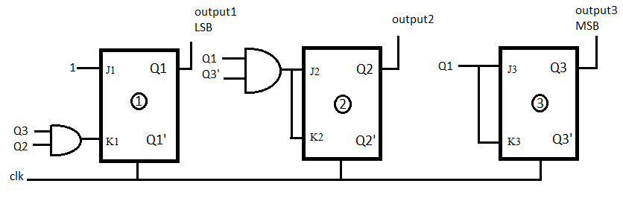
Implementation of the design
J3=Q1 K3= Q1
J2=Q3’Q1 K2= Q3’Q1
J1= 1 K1= Q3Q2

Slide 18
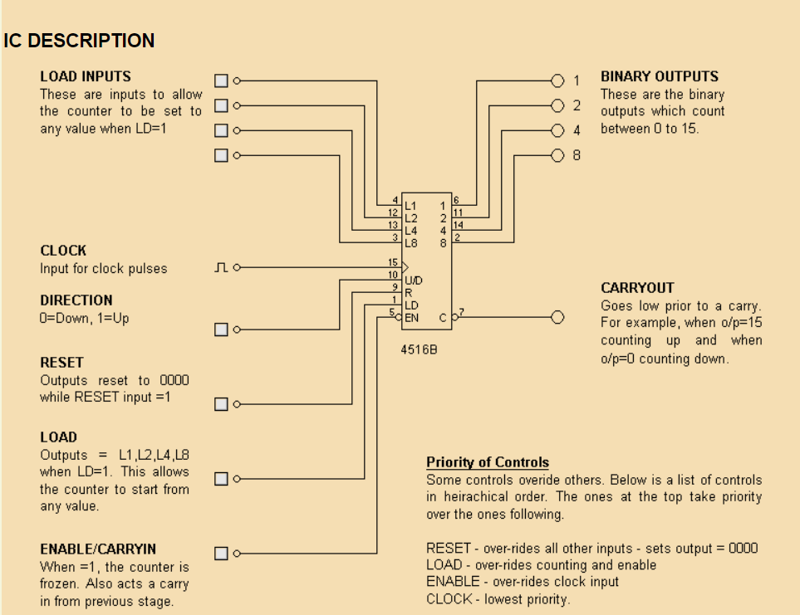
Presettable counters
USING THE 4516, 4 BIT BINARY COUNTER
Presettable:
This means when the LD input is high, then whatever binary value is present on LOAD INPUTS, will be immediately copied to the outputs and stay that way until LD goes low. This enables the counter to begin from any value.
Eg: Count from 6 to 15.
Note: This only works if the RESET input is low.

Slide 19
